Slide 1
The Hero’s Journey
A Guide to Literature

Slide 2
Presentation Overview
The men behind the Hero’s Journey Pattern
Archetypes
The Hero’s Journey and its parts

Slide 3
Early Theorists
Max Muller, Comparative Mythology (1856)
Sir Edward Burnett Tyler, Primitive Culture: Researches into the Development of Mythology, Philosophy, Religion, Language, Art and Custom (1871)
Otto Rank, Birth and Death of the Hero (1909)
Sir James George Frazer, The Golden Bough: A Study in Magic and Religion (1911-1915)

Slide 4
The Big Guns
Carl Jung
Joseph Campbell

Slide 5
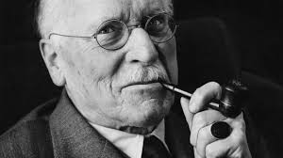
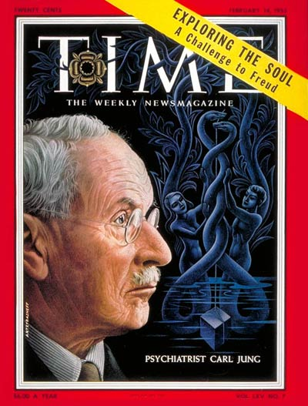
Jung
1875-1961
Psychiatrist
Influenced religion, philosophy, archeology, anthropology, literature, and other humanities
Collective unconscious
Archetypes

Slide 6
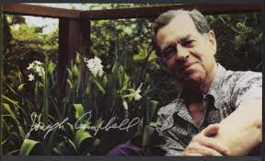
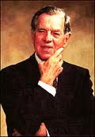
Joseph Campbell
1904-1987
Born and raised in White Plains, NY
Fascinated with American Indians from a young age
Voracious reader
Professor at Sarah Lawrence College

Slide 7
Archetypes
A constantly recurring symbol or motif
A pattern of thought

Slide 8
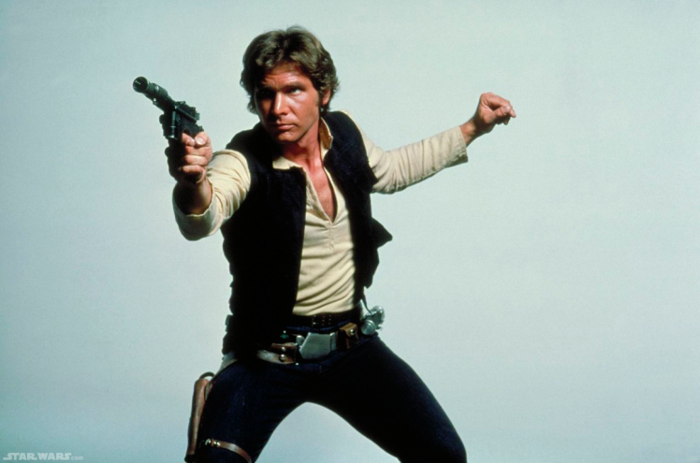
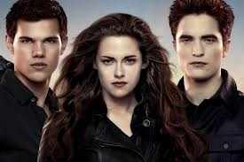
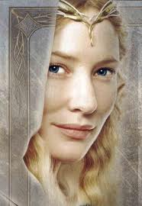
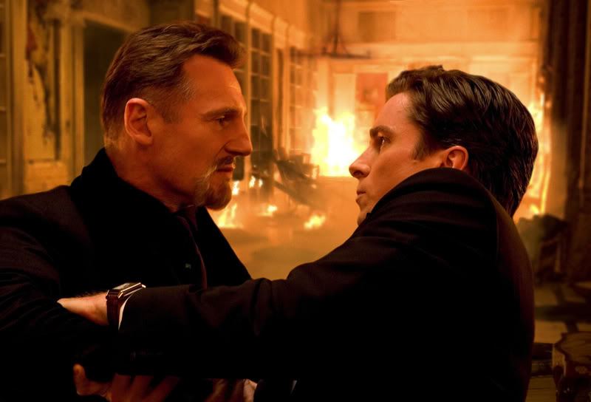
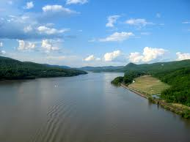

Slide 9
Common Archetypes
Meals
Weather
Violence
Seasons
Geography
Water
Illness
Christ-figures
Mother-figures
Father-figures
Disabilities, scars, and injuries
Flying

Slide 10
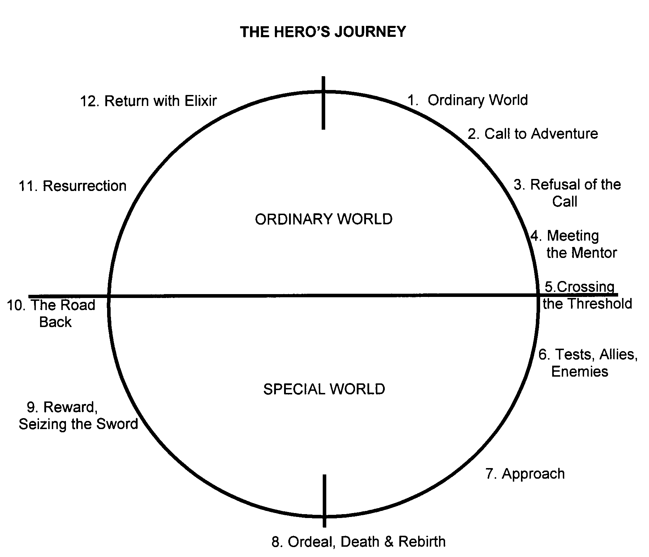

Slide 11
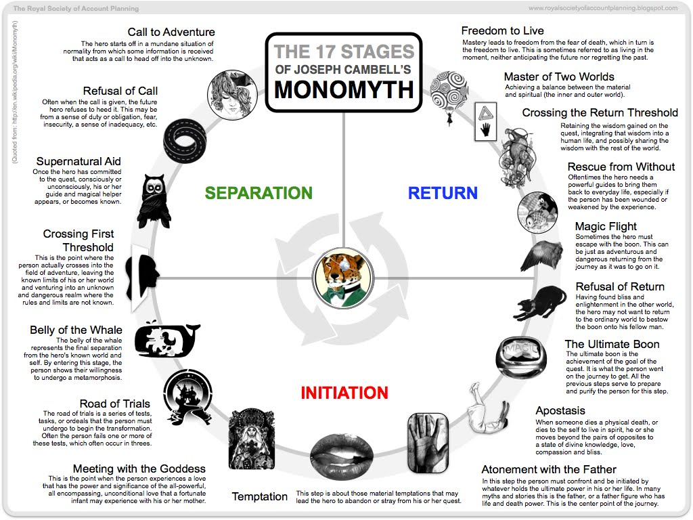

Slide 12
